Slide 1
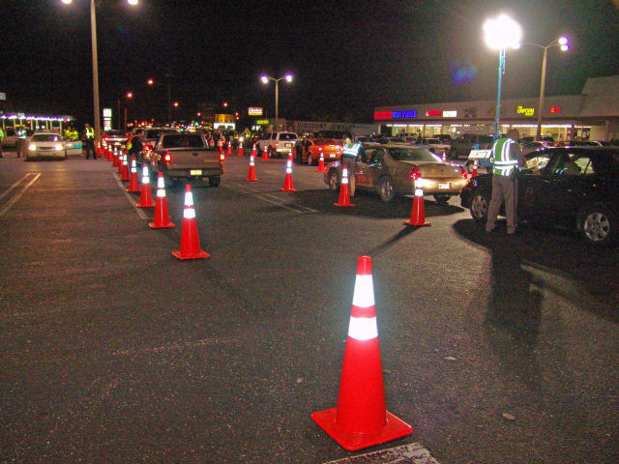

Sobriety Checkpoint Operations
Guidelines
IDOT/BSPE
Mandatory Grantee Meeting

Slide 2

Sobriety Checkpoint Operations
Legal, Effective, and Safe.
These points are consistent with those specified in court decisions, including the United States Supreme Court ruling :
Michigan Department of State Police v. Sitz,
Upholds the constitutionality of sobriety checkpoints
.

Slide 3
Sobriety Checkpoint Operations
General Guidelines.
Part of an ongoing program to deter impaired driving
The RSC place under existing policy and guidelines
Site selection
Use of warning devices
Displaying a visible police authority
Logistics of chemical testing at sobriety checkpoint
Contingency planning – Frequency Changes
Detection and investigation techniques
Operational briefings
Communication strategy – Media notification
Data collection and evaluation
Evaluation of sobriety checkpoint operations
.

Slide 4
Sobriety Checkpoint Operations
General Guidelines.
Operational Plan
  For conducting sobriety checkpoints that focuses on the responsibilities of the personnel. Michigan vs. Sitz
  The most critical factor to a roadblock
Supervision
The checkpoint supervisor coordinates all checkpoint activities in accordance with the department’s operational plan.
.

Slide 5
Sobriety Checkpoint Operations
General Guidelines.
Traffic Flow and Vehicle Stopping
Determining traffic flow will suggest whether all vehicles can be examined without causing a traffic build-up.
If the traffic volume precludes stopping every vehicle, a
nondiscretionary scheme should be adopted, in advance,
for stopping some subset of vehicles.
If every vehicle is not stopped, the method used to determine which ones will must appear in the operational plan authorizing the use of the sobriety checkpoint.
.

Slide 6
Sobriety Checkpoint Operations
General Guidelines.
Contingency Plan
Any deviation from the predetermined plan for stopping vehicles should be thoroughly documented and the reason
for the deviation given (e.g., traffic backing up, intermittent
inclement weather). Frequency Log
Specifying the method for selecting motorists to be contacted will ensure consistency and objectivity.
.

Slide 7
Frequency Log
.

Slide 8
Sobriety Checkpoint Operations
General Guidelines.
NHTSA Roadside Safety Check Protocols
IACP - Highway Safety Desk Book
Section 5 – Roadside Safety Checks & DWI Sobriety Checkpoints
https://rosap.ntl.bts.gov/view/dot/39335
NHTSA/ USDOT - Saturation Patrols and Sobriety Checkpoints
DOT HS 809 063
https://www.nhtsa.gov/book/countermeasures-that-work/alcohol-impaired-driving/countermeasures/enforcement/high-visibility-saturation-patrols
Low Staffing Sobriety Checkpoints
DOT HS 809 999
https://www.iadlest.org/Portals/0/Files/Documents/DDACTS/Docs/Low-Staffing%20Sobriety%20Checkpoints,%20DOT%20HS%20810%20590,%20April%202006.pdf

